Slide 1
Web page Functionality Based Path Coverage
Han Wei Guang
Zofia Marciniak
Anton Shatokhin
Brandon Ong

Slide 2
Contents
Problem Description
Our goals on the project
What we have done
What we are working on right now

Slide 3

Problem description
We want to lighten the workload of software developers that practices Test Driven Development (TDD) by generating automated tests cases base off the Figma Design

Slide 4
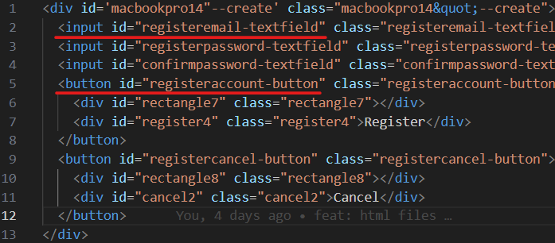
Two goals (Functional components and paths)
Functional components
Buttons
Inputs

Slide 5
Two goals (Functional components and paths)
Functional components
Buttons
Inputs
Paths/Routes
exampledomain.org/paths
Login
Mail
Setting
Root
Create

Slide 6







High Level Workflow
Element Presence
Pass
Fail
Element Pathing

Slide 7
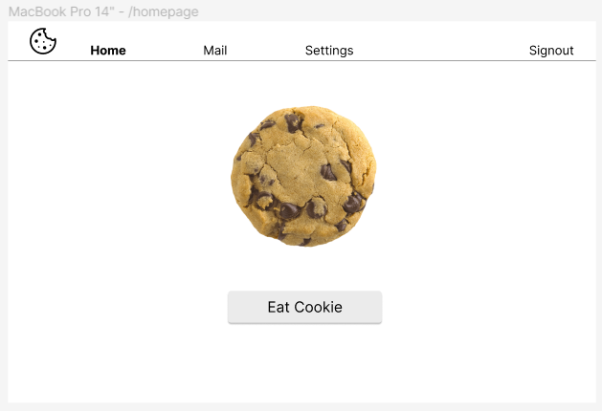
Example Figma Design

Slide 8
Example

Slide 9
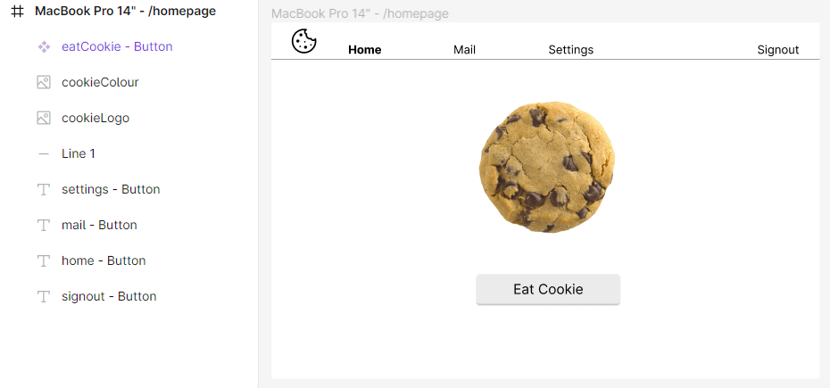
Figma Plugin -> HTML

Slide 10
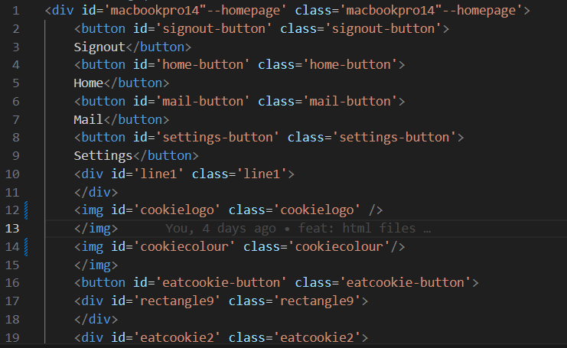
Figma Plugin -> HTML (Oracle)

Slide 11
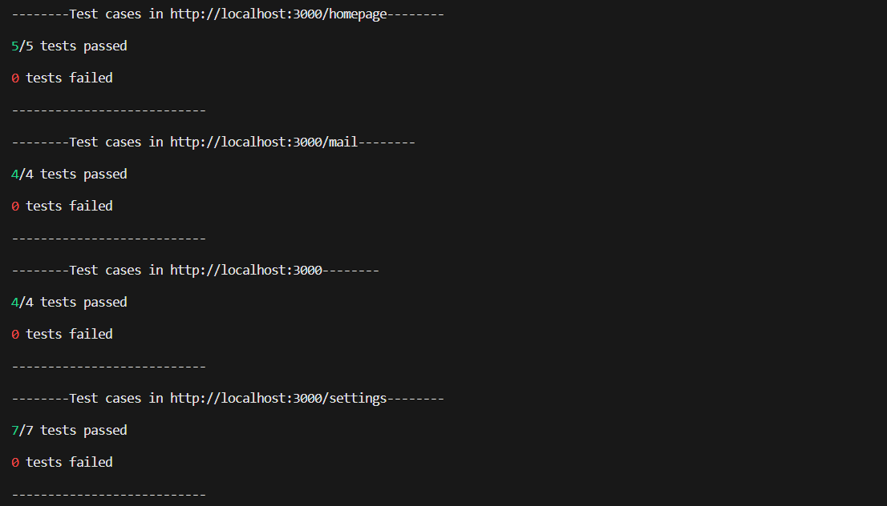
Running the Program

Slide 12
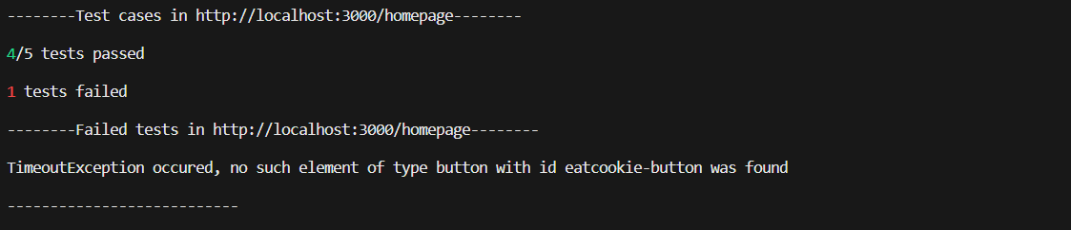
Running the Program

Slide 13
Running the Program

Slide 14
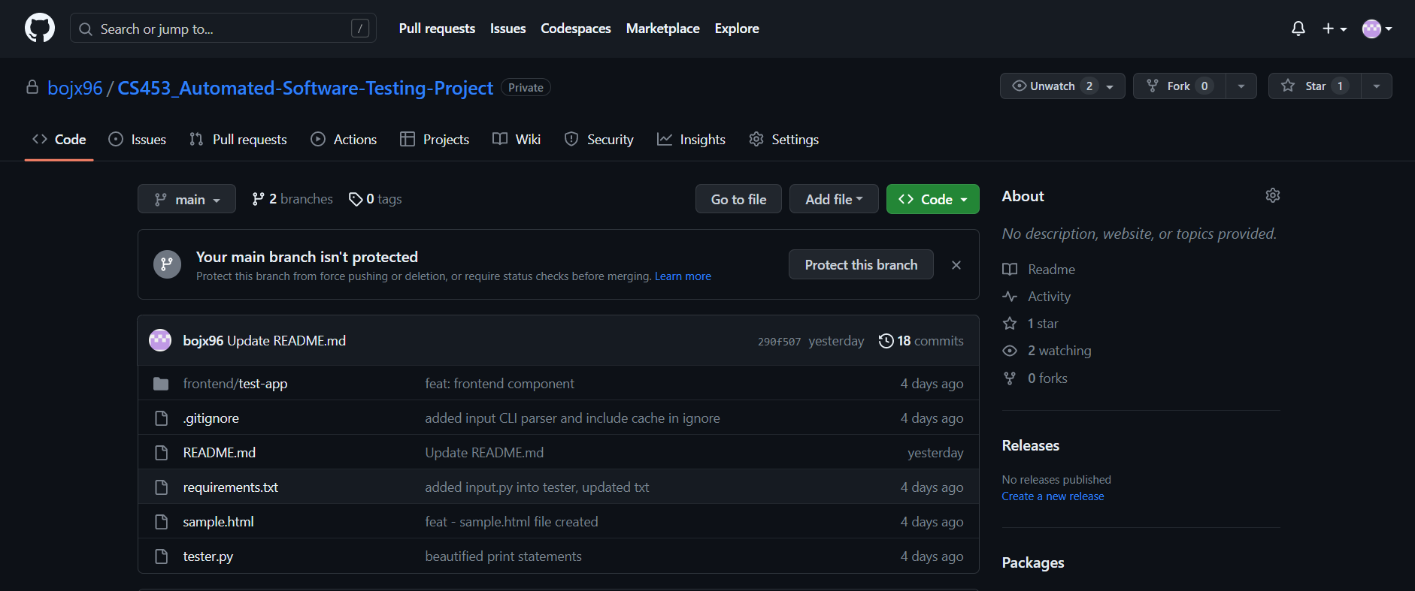

Many Buttons

Slide 15


What’s left
Functional components
Buttons
Inputs
Paths/Routes
exampledomain.org/paths
Login
Mail
Setting
Root
Create

Slide 16
Dependencies of Pages
Web Session Data
Browser Cookies

Slide 17
Dependencies of Pages
Web Session Data
Browser Cookies
Pages A -> B -> C = Error when reaching page C
Pages A -> C = No Error when reaching page C

Slide 18

Routing Test / Path Coverage
Create
Root
Homepage
Mail
Setting

Slide 19

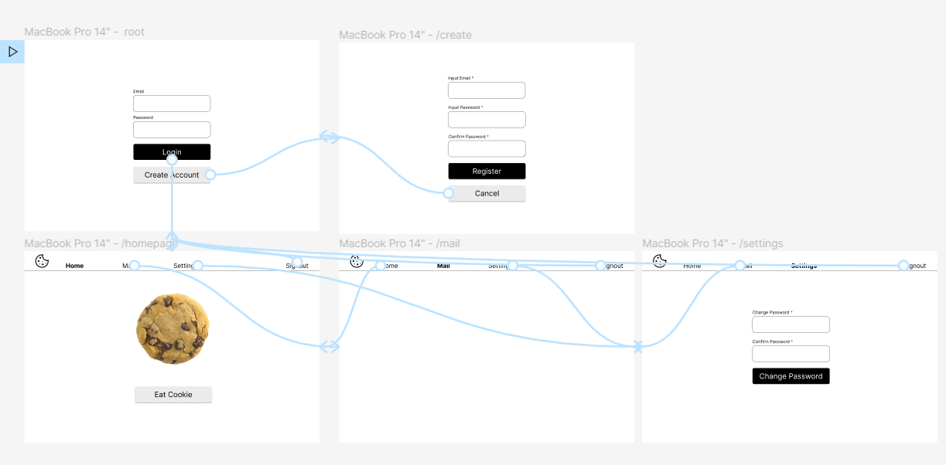
Routing Test / Path Coverage

Slide 20
Routing Test / Path Coverage
Homepage
Login button
Root
Create button
Create

Slide 21
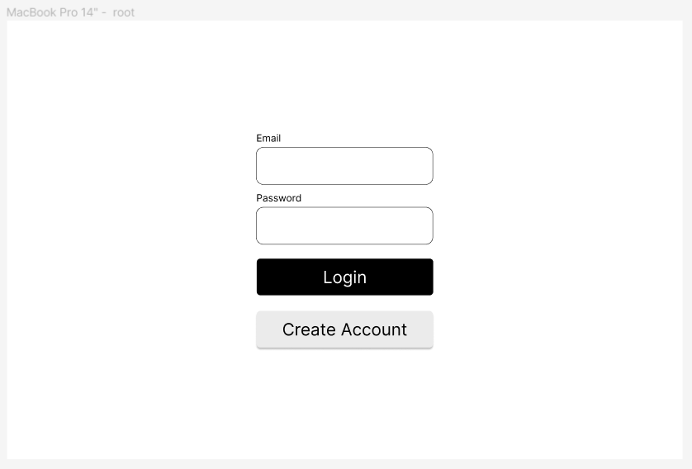
Routing Test / Path Coverage

Slide 22
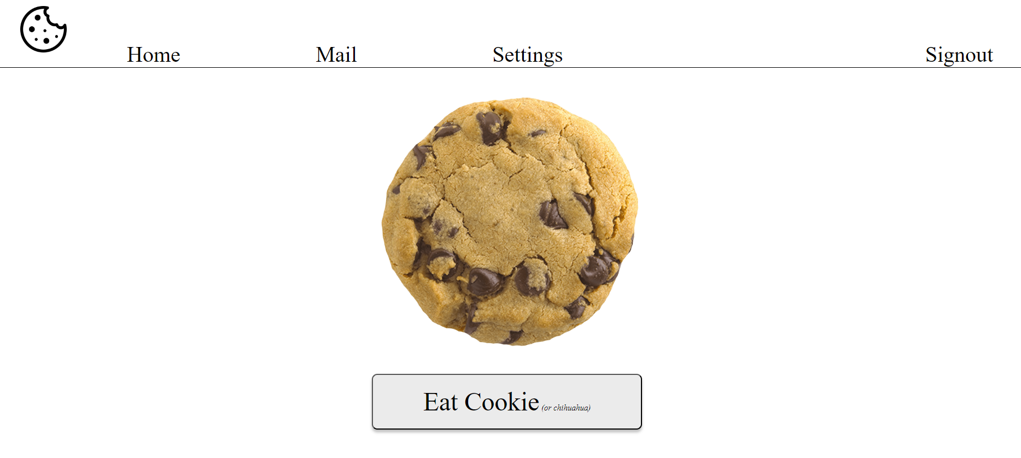
Routing Test / Path Coverage

Slide 23
Setting
Setting Button
Homepage
Mail
Mail Button
Login button
Root
Sign out Button
Login
Create button
Create

Slide 24
Dependencies of Pages
Traverse every edges with DFS algorithm
We deal with finite webpages
We take paths where you only visit the page once

Slide 25

Demo Video

Slide 26
Summary
What our program aims to do
General workflow of our program
What we are done with our program and what we are working on
Why we want to achieve web page path coverage

